Slide 1
Animals and their teeth
Done by: Carina & Carol 3A

Slide 2
Animals use their teeth for feeding. Their teeth come in many shapes and sizes. Different kinds of teeth do different jobs. Some animals don’t have any teeth and feed in other ways.

Slide 3
How animals feed?
When animals feed they take food into their bodies. Animals can feed by biting, drinking, chewing, sucking, filtering food or swallowing it whole.

Slide 4
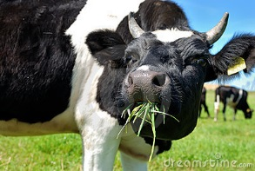
How do animals eat?
A cow can eat by chewing
A dog and a cat can drink by licking

Slide 5
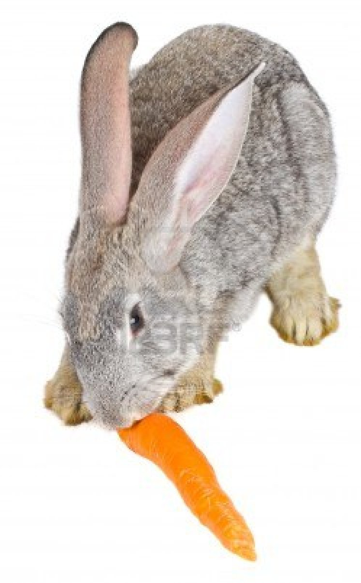
A butterfly can eat by sucking
A rabbit can eat by gnawing

Slide 6
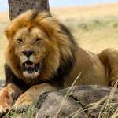
A snake can eat by swallowing
A lion can eat by tearing

Slide 7
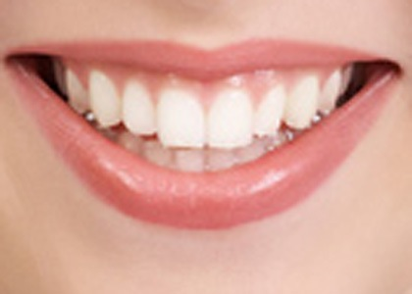
Humans can eat by chewing, biting, grinding
A blue whale can eat by filtering

Slide 8
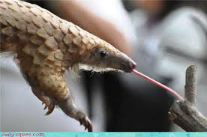
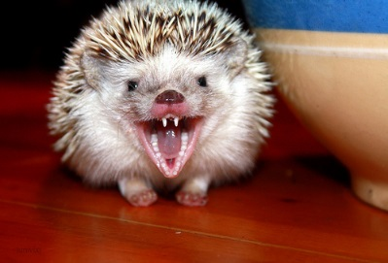
Different Types of teeth
Pangolin tongue
The pangolin does not have proper teeth. It eats ants and termites with its long, sticky tongue. It crushes its food in its stomach.
A hedgehog has small, very sharp teeth to chew grubs, worms and beetles.
A cow has broad flat teeth for grinding grass. It has no top teeth at the front. Its bottom front teeth are sharp and cut the grass on the upper gum, like a knife on a chopping board.
Hedgehog teeth

Slide 9
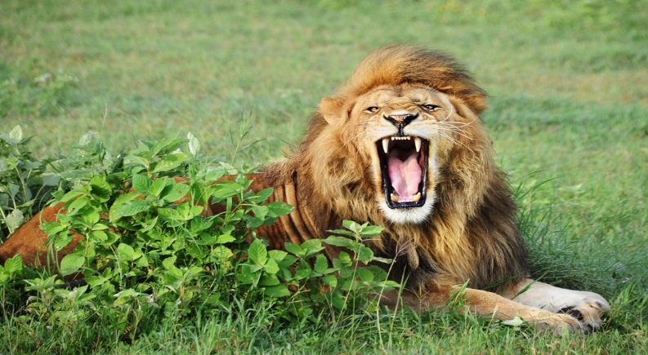
Lion teeth
A lion`s mouth has huge, sharp pointed teeth at the side for capturing and killing animals . Its back teeth are like scissors .They cut flesh into smaller lumps for swallowing.
Humans have front sharp teeth called incisors. They are used for cutting food. Pointed side teeth called canines tear and hold food. At the back, flat-topped premolar and molar teeth grind and chew food.
Human teeth

