Slide 1
Milk teeth & Permanent teeth
Ways to look after your teeth

Slide 2
Milk teeth
How many milk teeth are there altogether?
20.
What are the different kinds of milk teeth?
Incisors
Canine
Molars

Slide 3
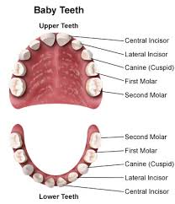
How many of each kind are there in full set of milk teeth ?
4 incisors up and 4 down
2 canine up and 2 down
4 molars up and 4 down

Slide 4
Permanent teeth
How many permanent teeth in human body?
32.
How many different kinds of permanent teeth are there?
Incisors
Canines
Premolars
Molars

Slide 5
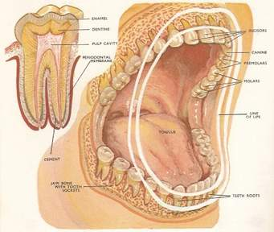
How many of each kind are there in full set of Permanent teeth?
4 incisors up and 4 down
2 canines up and 2 down
4 premolars up and 4 down
6 molars up 6 molars down

Slide 6
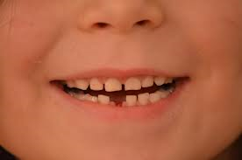
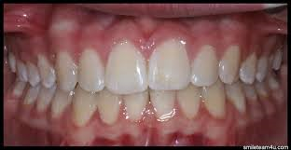
Comparison Between Milk and Permanent teeth
Small
20 teeth
White color
Can be replaced
Big
32 teeth
Pale yellow
Cannot be replaced

Slide 7
Function of each type of tooth
Incisors------------------
Canines------------------
Molars ------------------
Cutting and Slicing
Gripping and tearing
Crushing and chewing

Slide 8
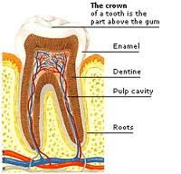
What is a Tooth made of?
-Enamel
-Dentine
-Pulp cavity
-Cement
-Gums

Slide 9
More likely harmful for teeth -Candy -Cake -Chocolate -Fizzy drinks
It is very important
To watch out what you are eating
Less harmful food for teeth:
-Apple
-Banana
-Water
-Pear
-Carrot
Biscuits

Slide 10
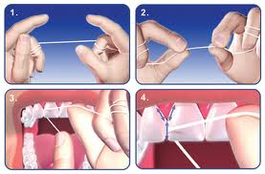
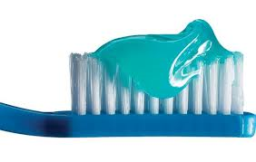
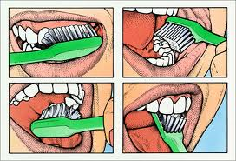
How do you take care of your teeth?
Brush your teeth twice a day.
Drink water after meals to rinse food from teeth and gums.
Visit the dentist to check your teeth twice a year.
Clean teeth after meals and before going to bed.
Eat more fruits and raw vegetables as snacks.

Slide 11
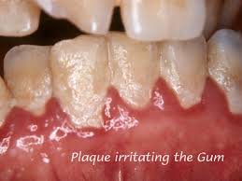
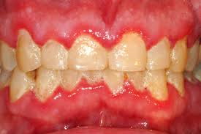
What id plague?
A thin layer of bacteria that form on the teeth and gums that can cause decay.

Slide 12
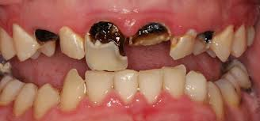
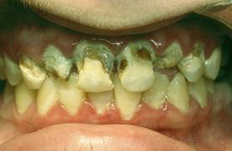
What causes tooth decay?
The sugar in the food is converted by bacteria into acid , which dissolves the tooth enamel and causes tooth decay.

Slide 13
NOUR YOUSSEF
3B

