Slide 1
Milk teeth & Permanent teeth

Slide 2
Milk teeth
How many milk teeth?
20.
What are the different kinds of milk teeth?
Incisors
Canine
Molars

Slide 3
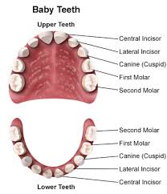
How many of each kind are there in full set of milk teeth ?
4 incisors up and 4 down

Slide 4
Permanent teeth
How many permanent teeth in human body?
32.
How many different kinds of permanent teeth are there?
Incisors
Canines
Premolars
Molars

Slide 5
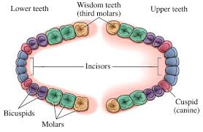
How many of each kind are there in full set of Permanent teeth?

Slide 6
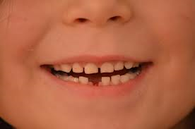
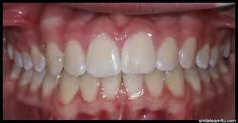
Comparison Between Milk and Permanent teeth
20 teeth
White colour
Can be replaced
32 teeth

Slide 7
Function of each type of tooth
Incisors
Canines
Cutting and Slicing
Gripping and tearing

Slide 8
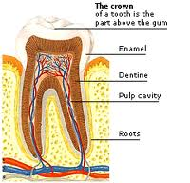
What is a Tooth made of?
Enamel
Dentine
Pulp cavity
Cement
Gums

Slide 9
Watch what you eat

Slide 10
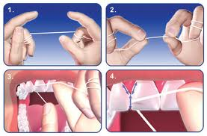
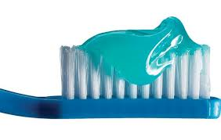
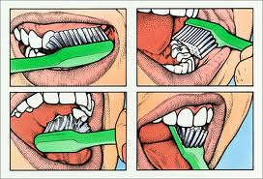
How do you take care of your theeth

Slide 11
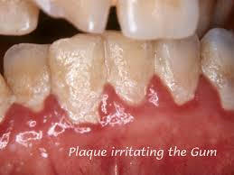
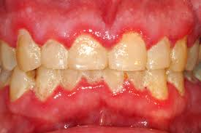
What id plaque?

Slide 12
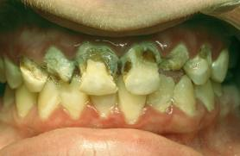
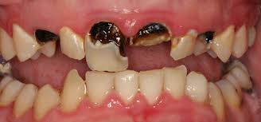
What causes tooth decay?

Slide 13
NOUR YOUSSEF
3B

