Slide 1
Teeth And Eating
Made by: Ezzat Mohamed 3A

Slide 2
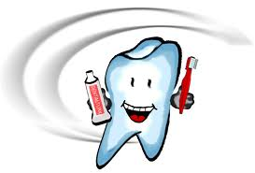
MILK TEETH : FIRST TEETH OF THE CHILD. THERE ARE 20 MILK TEETH.

Slide 3
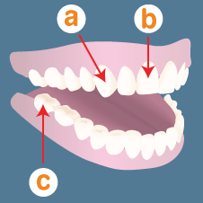
What are different kinds of teeth ?
-Humans have three main types of teeth:
a. Canines - used for tearing and ripping food.
b. Incisors - help you bite off and chew pieces of food.
c. Molars - help you crush and grind food.

Slide 4
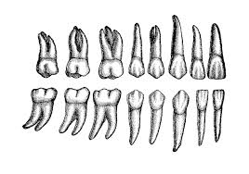
INCISORS ,CANINE AND MOLAERS

Slide 5
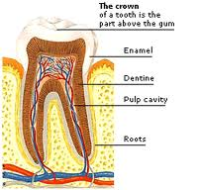
What is a tooth made of?

Slide 6
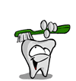
How can I look after my teeth?

