Slide 1
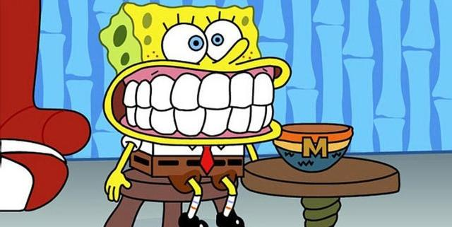
Teeth !!
Teeth are used to help break down food.
Humans have a variety of teeth including molars, premolars, canines and incisors

Slide 2
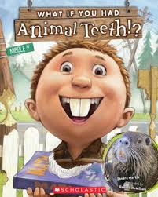
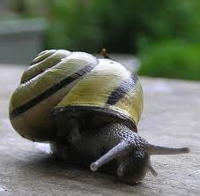
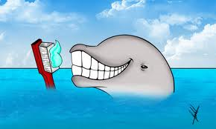
A snail’s mouth is no bigger than the head of a pin, but its tongue can have as many as 25,000 teeth!

Slide 3
How to care for our Teeth !!
Brush at least twice a day, after breakfast and before bedtime.
Visit the dentist twice a year.
Brush all of your teeth, not just the front ones.

Slide 4
Avoid sugar and eat lots of fruits and vegetables and drink water
Use only toothbrushes with soft bristles.
Learn how to floss your teeth.

Slide 5
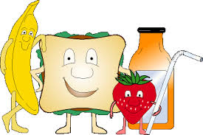
Drink plenty of water after eating food
Good Eating Habits

Slide 6
Plenty of plant foods, such as fruit, vegetables, bread and other gain-based foods.

Slide 7
Josiah Thomas Sony – 3A
“Thank you 4 watching”

