Slide 1
What and how animals feed
Feeding in animals

Slide 2
Some animals feed by sucking the fluids out of another plant or animal.
Can you name few such animals?
Lets see some.

Slide 3
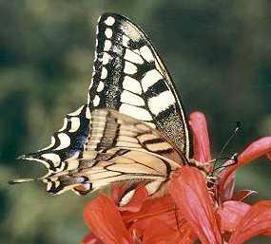
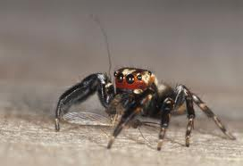
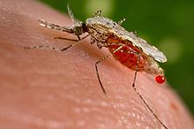
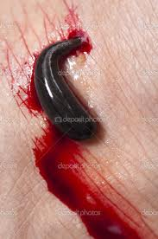
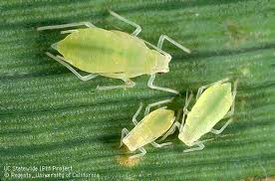
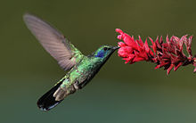
Butterfly Spider Mosquito
Aphid Humming bird Leech

Slide 4
Aphids, also known as plant lice, are small sap sucking insects.
Butterfly sucks nectar from the flower using proboscis.
The hummingbird laps nectar using a long tongue with a brushy tip. Nectar flows along two troughs in the tongue by a process called capillary action (this is not sucking, its drinking).
Spiders pump digestive enzymes through fangs into their prey, then suck the digested and liquefied tissues of their prey.
Leeches are 'worms' with suckers on each end to suck the blood.
Mosquitoes feed by sucking blood from animals using proboscis.

Slide 5
Some animals feed by swallowing its food whole.
Do you know any animals that feed by swallowing whole?
Lets see some.

Slide 6
Some animals like frogs, lizards and snakes swallow their food whole.
The owl is a bird that does not chew its food, but swallows most of it whole.
A sea lion uses its pointed teeth to catch its food, then
swallows it whole.

Slide 7
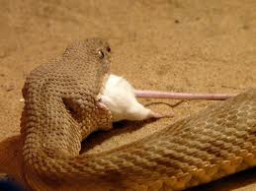
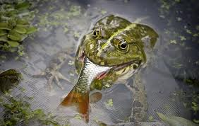
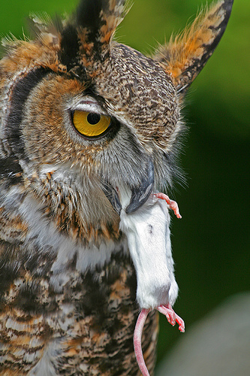
snake
Frog
Sea lion
Owl

Slide 8
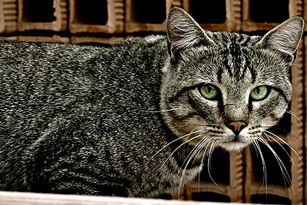
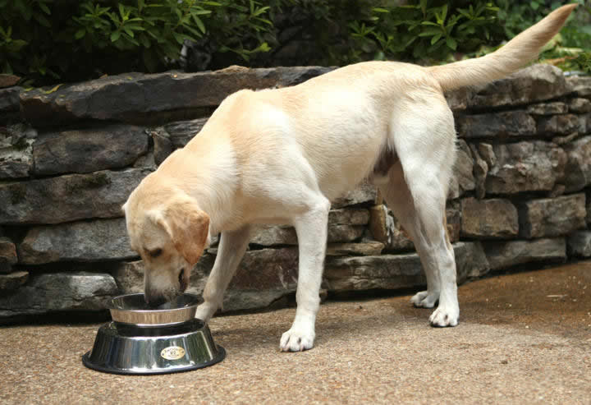
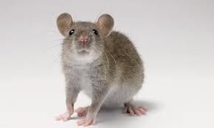
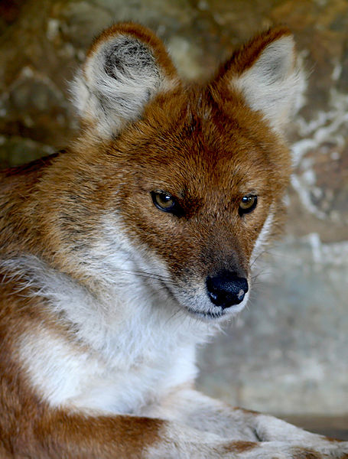
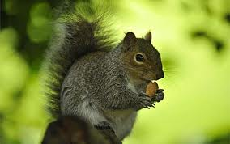
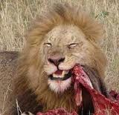
Some animals like rats and squirrels have gnawing teeth that help them to bite through hard nuts.
Dogs, cats, lions, tigers and wolves bite and chew their food.

Slide 9
Filter feeding is the feeding mode found among flamingoes, sponges, Moon Jellies, krill, three species of shark, and many whale species, such as the baleen whale. Of all feeding modes, this might be among the easiest: instead of requiring predatory or precision action, the filter feeder just exposes its filters and sieves them through food particles.

Slide 10
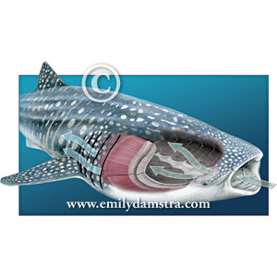
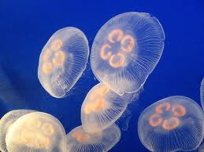
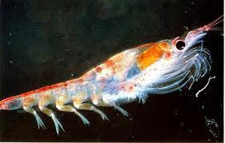
sponge
Whale
moon jellies
Krill

Slide 11
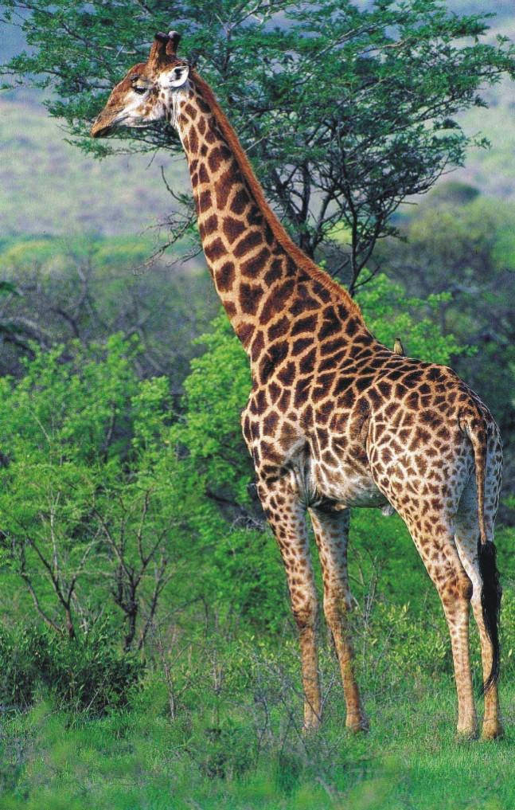
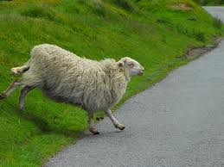
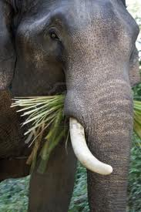
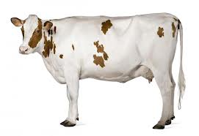
Dogs, cats, horses, cows, giraffes, sheep and people chew their food before they swallow it.

