Slide 2
There are 3 types of rocks
Igneous rock
Sedimentary rock
Metamorphic rock

Slide 3
Igneous rocks
Igneous rock is formed when magma cools and solidifies
Magma can be forced into rock, blown out in volcanic explosions or forced to the surface as lava
There are over 700 different types of Igneous rocks

Slide 4
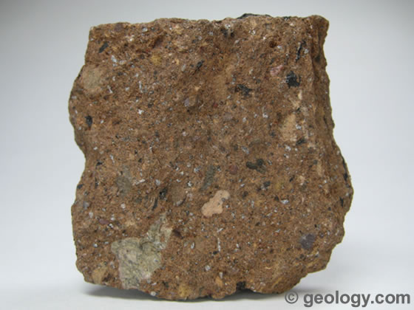
Tuff rock
Tuff is a type of rock consisting of consolidated volcanic ash ejected from vents during a volcanic eruption

Slide 5
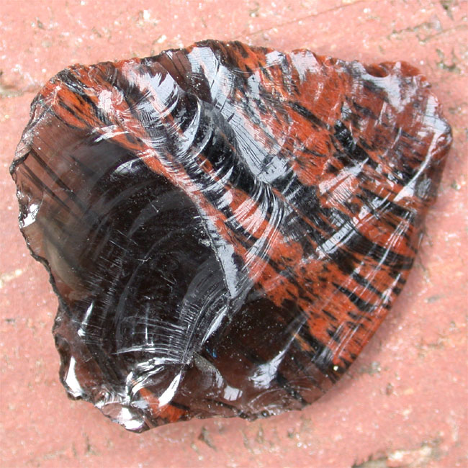
Obsidian
Obsidian is a naturally occurring volcanic glass formed as an extrusive igneous rock.
Obsidian is hard and brittle
It is used as cutting and piercing tool.

Slide 6
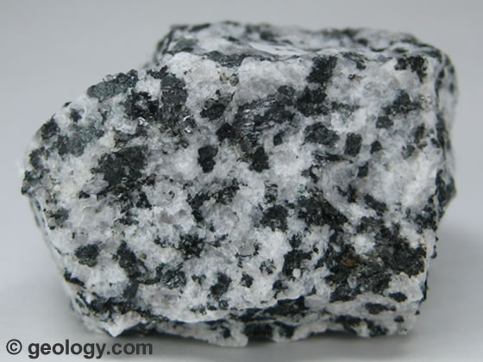
Diorite rock
Diorite has a medium grain size texture, occasionally with porphyry.
It is commonly produced in volcanic arcs

Slide 7
Sedimentary rock
Sedimentary rocks are formed by sediment that is deposited over time, usually as layers at the bottom of lakes and oceans.
This sediment can include minerals, small pieces of plants and other organic matter.
The sediment is compressed over a long period of time before consolidating into solid layers of rock.

Slide 8
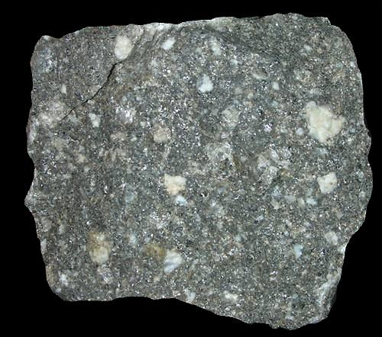
Greywacke
Greywacke is a variety of sandstone generally characterized by its hardness, dark color, and poorly sorted angular grains of quartz

Slide 9
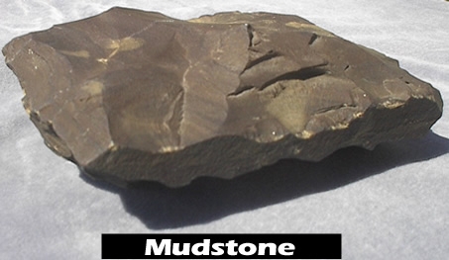
Mudstone
Mudstone is a fine grained sedimentary rock whose original constituents were clays or muds

Slide 10
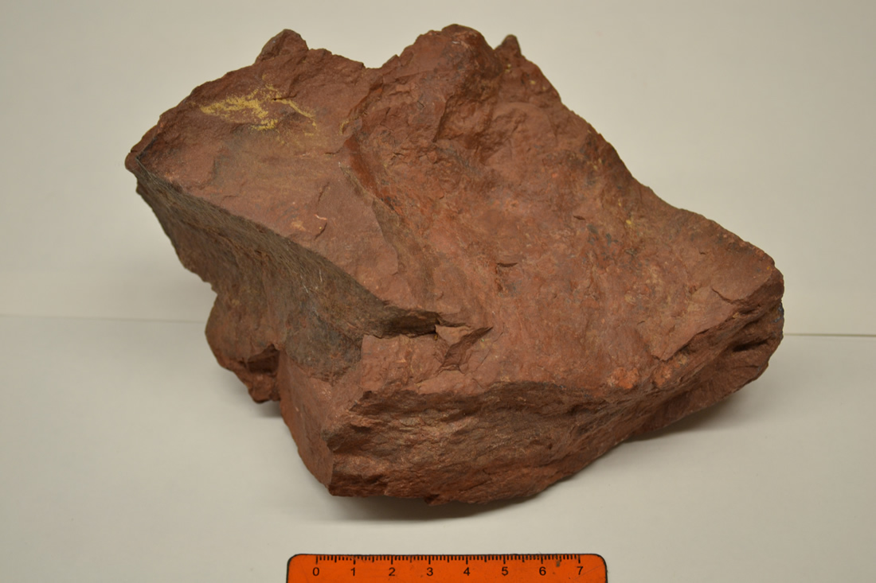
claystone
Claystone does not include clay shales which are rocks that are laminated or easily split into thin layers.

Slide 11
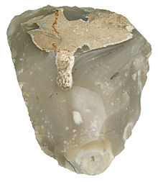
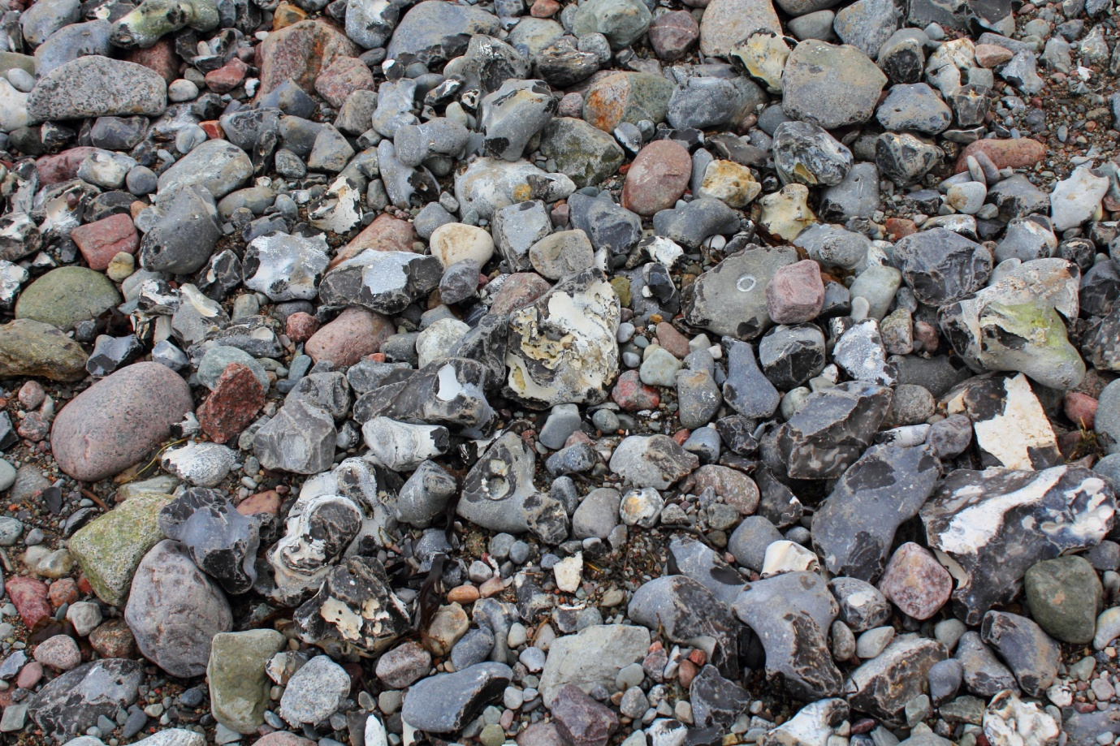
Flint
Flint is a hard , sedimentary rock

Slide 12
Metamorphic rock
Metamorphic rocks have been changed over time by extreme pressure and heat.
Metamorphic rocks can be formed by pressure deep under the Earth’s surface , from the extreme heat cause by magma.
Uplift and erosion help bring metamorphic rock to the Earth's surface.

Slide 13
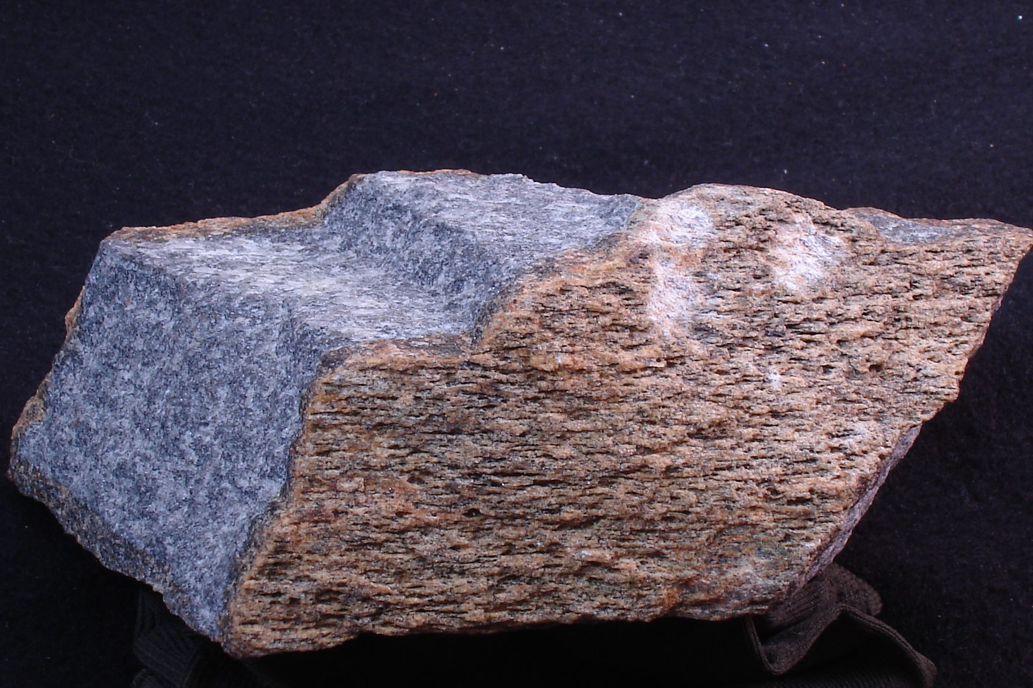
Granulite
Granulites are
medium to coarse
grained metamorphic
rocks that have
experienced high
Temperature
metamorphism

Slide 14
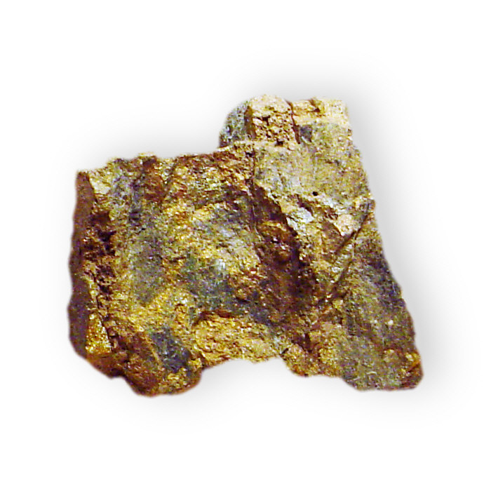
Schist
Schist is a medium
grade metamorphic
rock^{[1]} with medium
to large, flat, sheet
like grains.

Slide 15
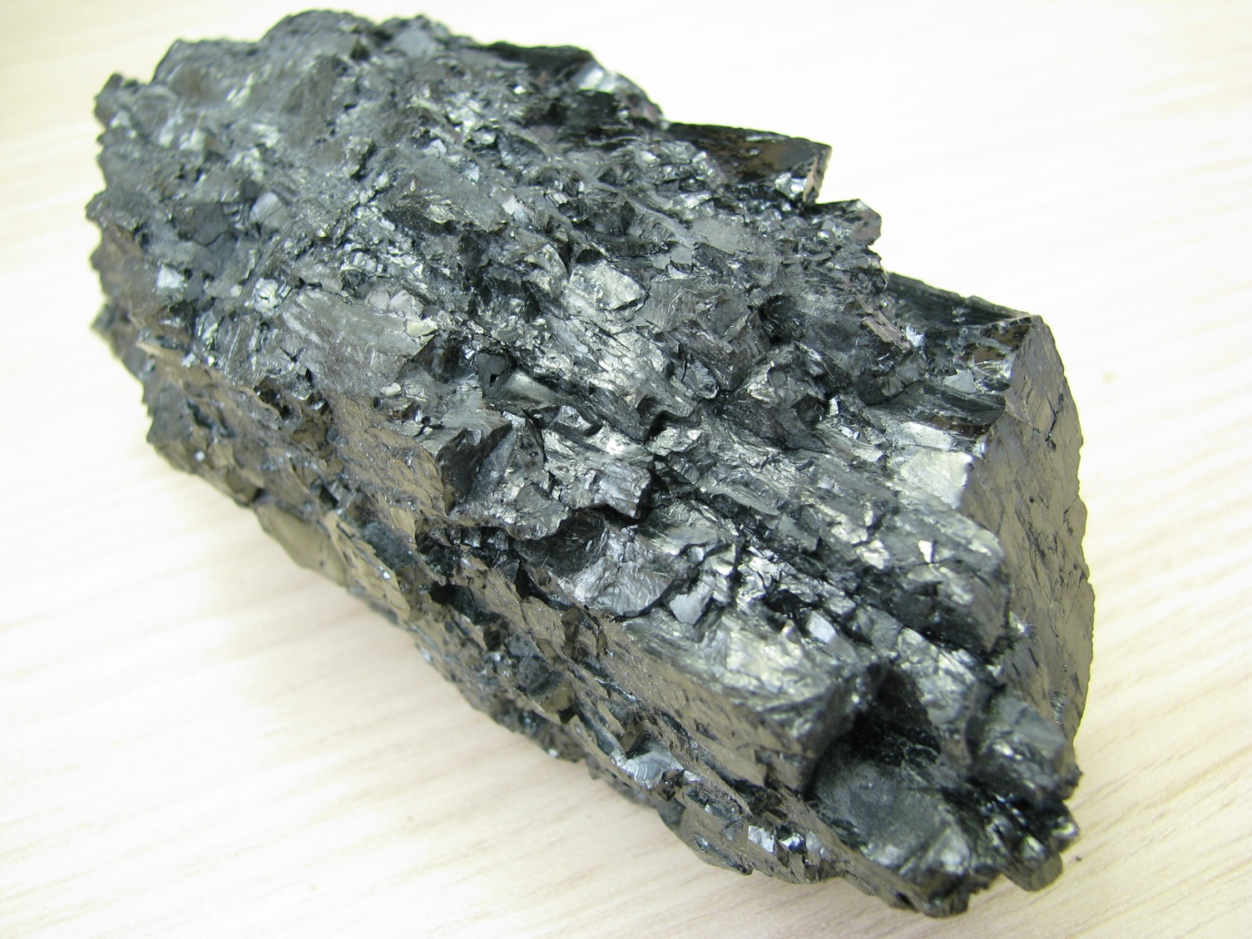
Athracite
Anthracite is the
most metamorphosed
type of coal in which
the carbon content is
between 92.

