Slide 1
Healthy Food
Balanced Diet

Slide 2
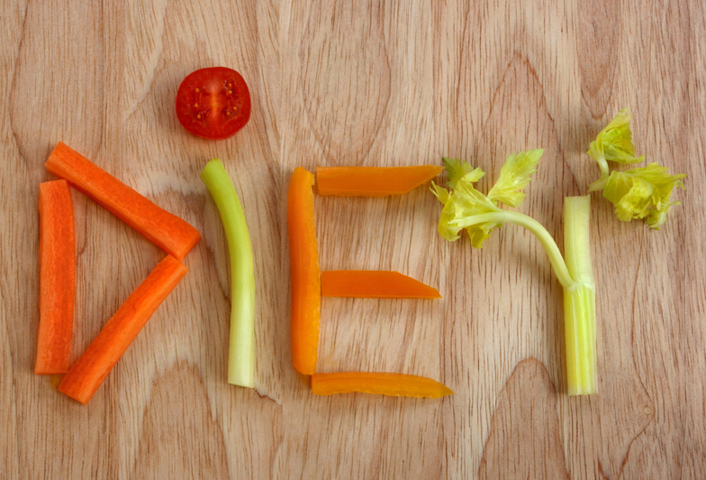
What is Diet?
Everything we eat is called our diet?

Slide 3
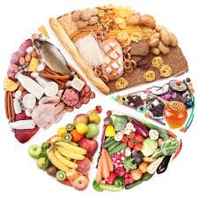
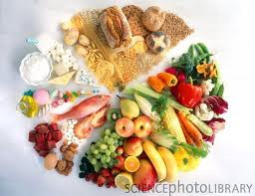
What is balanced diet?
Balanced diet includes food for growth and food for activity.

Slide 4
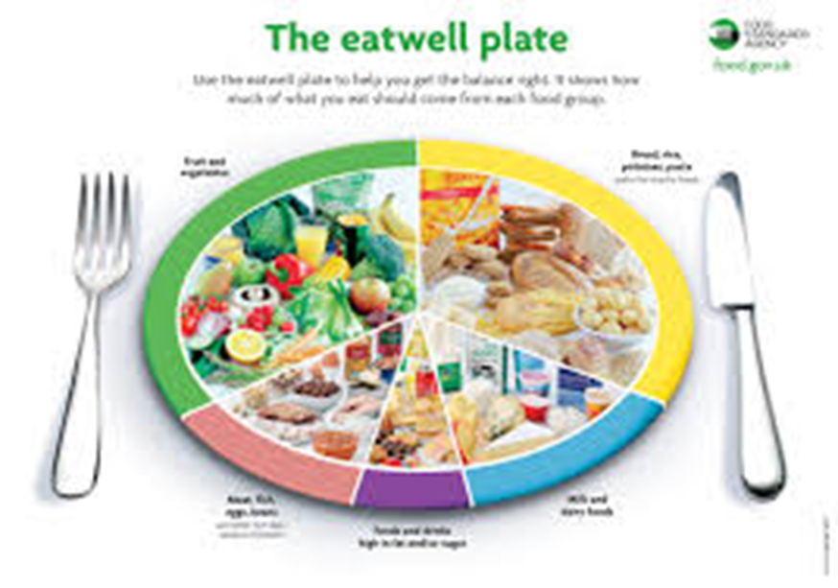

Slide 5
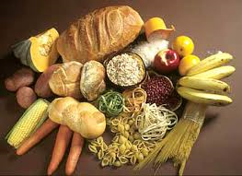
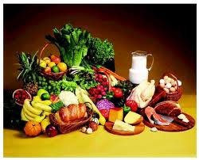
Food for Growth and Activity
Growth Food: Food for building up and repairing. Examples Milk,fish,chicken,meat,vegetables and fruits.
Activity Food: Energy giving food.
Ex:bread,pasta,rice,cereals and starchy food

Slide 6
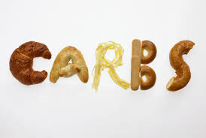
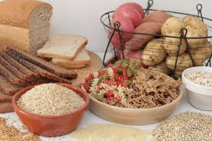
Carbohydrates
This group gives us carbohydrates for the energy that we need to keep our bodies running 24 hours a day.
Eat at least six servings of this group each day.

Slide 7
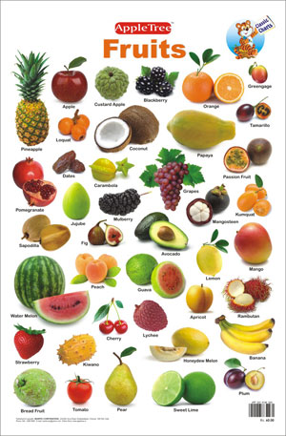
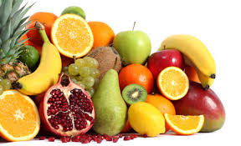
Fruits
This group of foods provide vitamin C to help our bodies heal cuts and bruises and fight infection too!
It also provides vitamin A that helps prevent diseases.
It also provides our bodies with so many other vitamins.

Slide 8
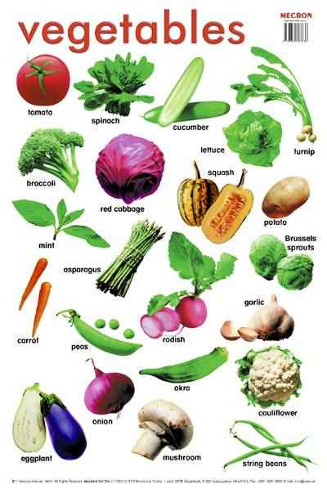
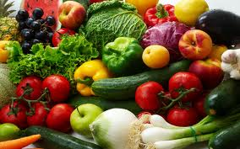
vegetables
.Vegetables are rich in minerals and fibers.

Slide 9
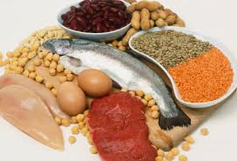
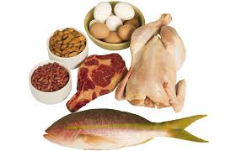
Protein
Body needs protein for body building and repairing

Slide 10
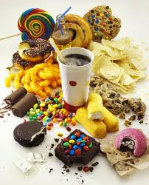
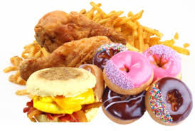
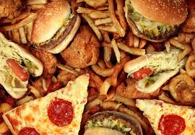
Sugar and Fats
Store of energy giving in the body .
Sweets,candy,chocolates,oil and butter.

Slide 11
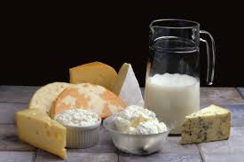
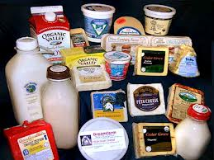
Milk
Milk and dairy products are good source of calcium .
Our bodies needs calcium to grow.

Slide 12
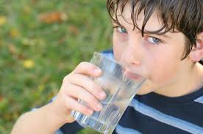
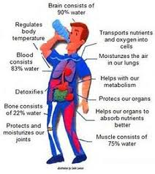
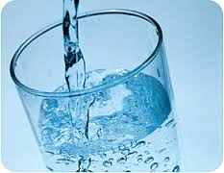
Water
Keeps your body clean and helps in digestion
Most of your body is water.

Slide 13
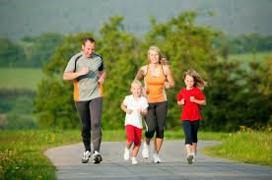
Conclusion
Our bodies need a balanced diet to maintain good health.
Our bodies need a balanced diet to fight diseases.

Slide 14
NOUR YOUSSEF 3B

