Slide 1
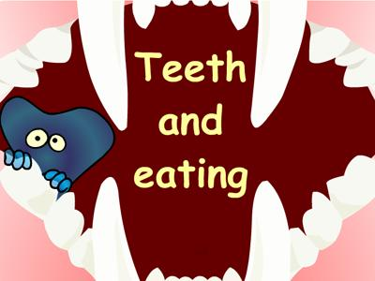
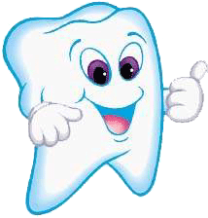
By: Lawrence Jason Gagtan

Slide 2
Parts of the teeth and functions

Slide 3
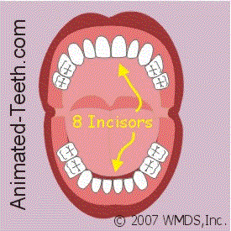
Parts of the teeth and functions

Slide 4
Central Incisors
is a human tooth in the front upper jaw, or maxilla, and is usually the most visible of all teeth in the mouth. It is located mesial (closer to the midline of the face) to the maxillary lateral incisor. As with all incisors, their function is for shearing or cutting food during mastication (chewing).

Slide 5
Lateral Incisors
are a pair of upper (maxillary) teeth that are located distally (away from the midline of the face) from both maxillary central incisors of the mouth and mesial (toward the midline of the face) from both maxillary canines. As with all incisors, their function is for shearing or cutting food during mastication, commonly known as chewing.

Slide 6
Canine
is the tooth located laterally (away from the midline of the face) from both maxillary lateral incisors of the mouth but mesial (toward the midline of the face) from both maxillary first premolars. Both the maxillary and mandibular canines are called the "cornerstone" of the mouth because they are all located three teeth away from the midline, and separate the premolars from the incisors.

Slide 7
1st Premolar
is one of two teeth located in the upper jaw, laterally (away from the midline of the face) from both the maxillary canines of the mouth but mesial (toward the midline of the face) from both maxillary second premolars. The function of this premolar is similar to that of canines in regard to tearing being the principal action during mastication, commonly known as chewing.

Slide 8
2nd Premolar
is one of two teeth located in the upper jaw, laterally (away from the midline of the face) from both the maxillary first premolars of the mouth but mesial (toward the midline of the face) from both maxillary first molars. The function of this premolar is similar to that of first molars in regard to grinding being the principal action during mastication, commonly known as chewing.

Slide 9
1st Molar
is the tooth located laterally (away from the midline of the face) from both the maxillary second premolars of the mouth but mesial (toward the midline of the face) from both maxillary second molars. The function of this molar is similar to that of all molars in regard to grinding being the principal action during mastication, commonly known as chewing.

Slide 10
3rd Molar
Most of us will develop a third molar tooth in each quadrant of our mouths, upper left, upper right, lower left lower right. The molars are the large grinding teeth in back. The last molars in the line are called 3rd molars or more popularly wisdom teeth. These teeth usually erupt, break through the gum tissue after the age of 17.

Slide 11
2nd Molar
is the tooth located distally (away from the midline of the face) from both the maxillary first molars of the mouth but mesial (toward the midline of the face) from both maxillary third molars. This is true only in permanent teeth. The function of this molar is similar to that of all molars in regard to grinding being the principal action during mastication, commonly known as chewing.

Slide 12
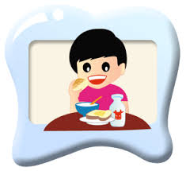
Eating
(also known as consuming) is the ingestion of food or other object, usually to provide heterotrophic organisms their nutritional or medicinal needs, particularly for energy and growth.

Slide 13
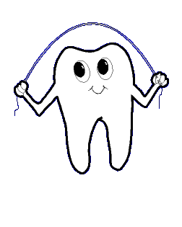
Eating process

Slide 14
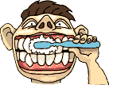
care for your teeth
Brush your teeth thoroughly at least twice a day, for two minutes each time
1

Slide 15
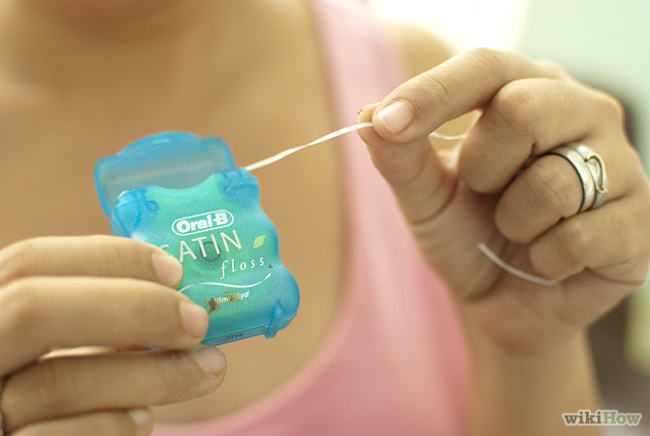
Care for your teeth
Floss your teeth daily and after any food that will stick in your teeth (i.e. corn on the cob, caramel, peanut butter, etc.).
2

Slide 16
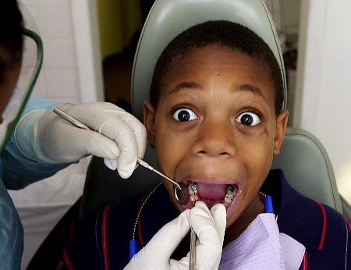
Care for your teeth
Visit your dentist at least every 6 months & every time you have a problem with your teeth.
3

Slide 17
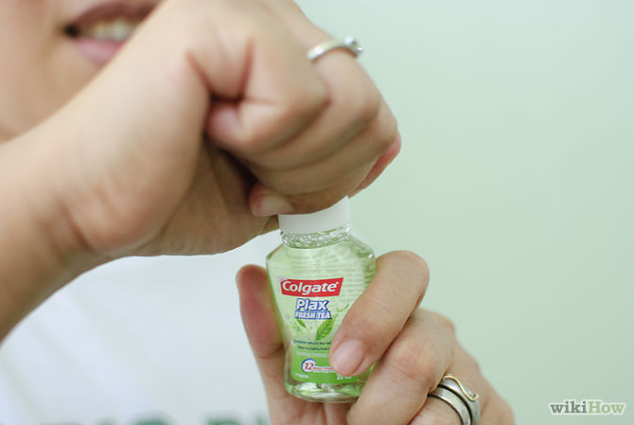
Care for your teeth
Find a fluoride mouthwash. Fluoride mouth washes help to strengthen tooth enamel.
4

Slide 18
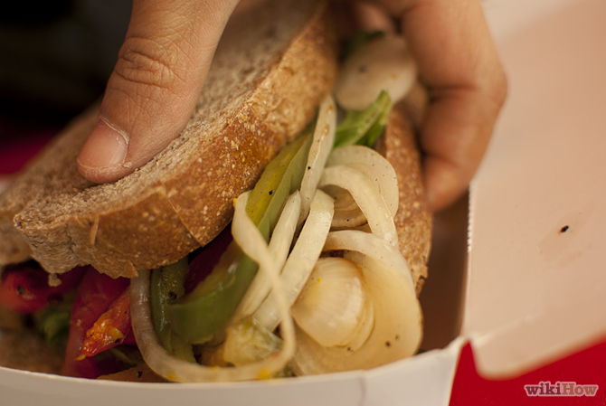
Care for your teeth
Choose Your Foods Wisely. Snacking constantly can cause plaque to build up on your teeth.
5

Slide 19
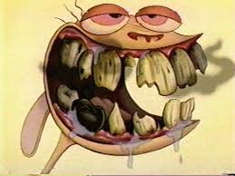
Lastly…
ALWAYS TAKE GOOD CARE OF YOUR TEETH SO YOU WILL NOT BECOME LIKE THIS

Slide 20
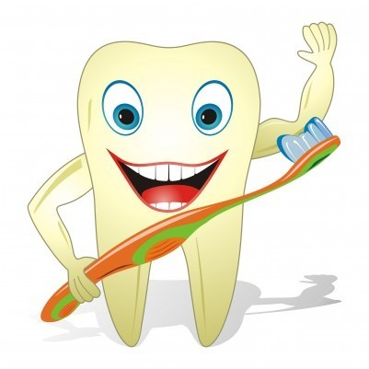
THANK YOU!!!

