Slide 1
Teeth and eating

Slide 2
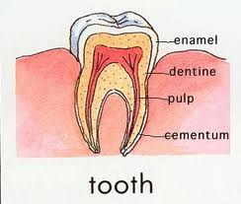
Let’s look at inside our teeth

Slide 3
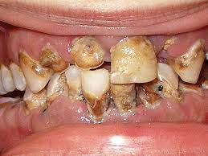
What will happens if we don’t brush our teeth.?
.

Slide 4
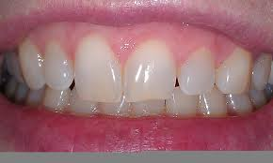
And what will happens if brush our teeth ?

Slide 5
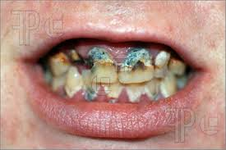
What is tooth decay ?

Slide 6
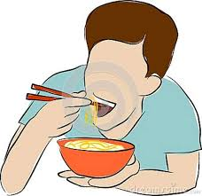
how do we eat?

Slide 7
What do we eat?

Slide 8
Thank
you

